Slide 1
Class and ID and Divs and Spans
(Oh, my!)

Slide 2



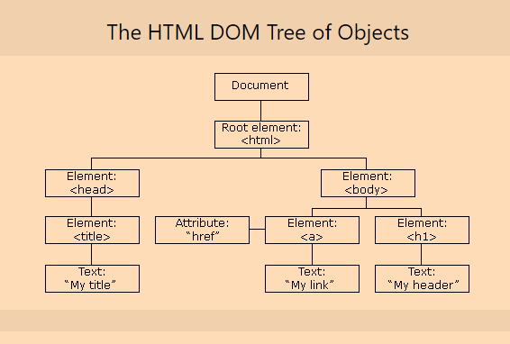
DOM
The Document Object Model is how a browser “understands” your page
It is a tree (computer science data structure term) of Objects

Slide 3
JavaScript
JavaScript is the language of the web (my opinion, not a fact)
JavaScript lets you have a dynamic page
What is a “dynamic” page?
The DOM gives JavaScript access to the page

Slide 4
What can you do with JavaScript?
Change any HTML element or attribute
Change any CSS style
Remove HTML elements or attributes
Add new HTML elements or attributes
Respond to or create events (we may talk about these near the end of class)

Slide 5
So what about the id attribute
This is an optional attribute on any HTML element
Values are case sensitive (George is different than GEORGE is different than george)
No whitespace
Must be unique

Slide 6
Id example

Slide 7

Then what about class
Class is an optional html attribute
Ids must be unique
You can have lots of the same classes
You can then “target” those classes with CSS
ID uses hashtag (octothorpe!) for styling
Classes use dots

Slide 8


Class Example

Slide 9
Spans
But why?

Slide 10
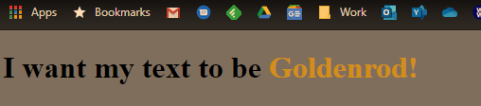
What do spans solve?
How would we do this?

Slide 11
I want to group some text
A span by itself does nothing
Until you style that span by targeting “span”, “#id”, or “.class” with CSS

Slide 12
Divs are just like spans
Spans are “inline”. The other text and stuff continues to flow around them.
Img, a, b, I, code, br are other inline tags
Divs are block level elements
P, ul, ol, h1-h6, are other block level tags
Divs start on a newline and expand to the full width of the block

Slide 13

Div/Span examples

Slide 14
Summary
ID lets you target something
Class lets you target many things
Spans and Divs give you flexible “containers” for stuff

